Slide 1
Creating a Mission Statement and Division-Wide Goals
"If you don't know where you're going, it doesn't matter which way you go." — Cheshire Cat, Alice in Wonderland
WVU - Potomac State College
17 January 2017
Dr. Barbara A. Copenhaver Bailey

Slide 2
Outcomes
After attending the workshop on Tuesday, January 17, 2017, participants will:
understand the importance of having a mission statement and division-wide goals
be able to identify the characteristics of a strong mission statement
understand the importance of establishing yearly and/or long term goals
be able to identify the characteristics of strong goals and objectives/outcomes

Slide 3
We’re Talking Strategic Planning
Typically a strategic Plan is visionary, often long term.
Any plan with details, focus, and/or steps is strategic.
We are focusing on 2017-18
Any planning you do must be tied back into the University and PSC Student Life priorities (Pillars, Domains, Goals)
If you do long-term strategic planning, you must revisit and adjust as, leadership and priorities often change at higher levels and impact each unit differently.

Slide 4
How Building on Each Level Looks
 | Level | Definition
⬇ ⬇ ⬇ | Division Mission Statement | The bold, short statement encompassing the work of the division and defining the reason for your existence.
 | Division Goals | Overarching goals that are true for the entire division. These are broad concepts that are essential to the mission of the division.
 | Unit Goals | This is not a typical yearly accomplishment of the unit but rather something you are trying to improve or something new you are striving to achieve.
 | Unit Objectives/Outcomes | There will be objectives/outcomes for each goal and these should be SMART. These are the things you should be able to measure to see if goals have been achieved.
 | Unit Action Items | There will be action items under each objective/outcome. These will define the steps you will take as you work towards achieving your objectives/outcomes.

Slide 5
The Student Life Division of Potomac State College at WVU inspires students to make meaning in their lives through student-staff engagement, programs and initiatives, self-discovery and reflection. The services we provide area based on a foundation of values to include: integrity, a commitment to excellence, wisdom, respecting human dignity and cultural diversity, compassion, humility and clear and concise communication.

Slide 6
What is a Mission Statement?
A one-sentence statement describing the reason an organization or program exists and used to help guide decisions about priorities, actions, and responsibilities.
A very simple and direct statement that is easy to understand and remember.
A one-sentence, clear, concise statement that says who the organization is, what it does, for whom and where.

Slide 7
Why Have A Mission Statement?
Your Mission is your core purpose
It helps you stay focused
You can refer to it during decision-making and problem solving
Make it
to the end of the semester

Slide 8
What are Division-Wide Goals?
Over arching goals that are true for the entire division.
Broken down more specific than the mission but are broad concepts that are essential to the success of the mission of the division.
Goals that are directly tied into the University Strategic Plan (Pillars & Domains)
Used for focus and consistency across the division and not for measurable outcomes

Slide 9
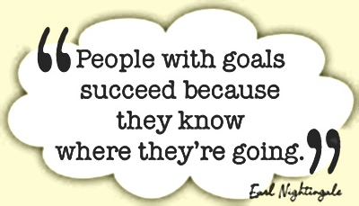
Why Have Division-Wide Goals?
Supports your mission
Gives units a foundation on which to base their goals & objectives/outcomes
It helps you stay focused
You can refer to it during decision-making and problem solving

Slide 10
